Slide 1
Bronchoalveolar lavage (BAL)
Automation of cell segmentation and counting

Slide 2
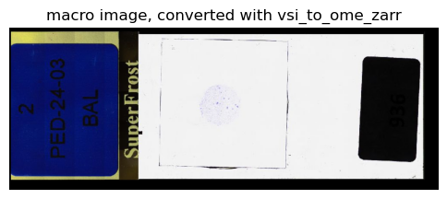
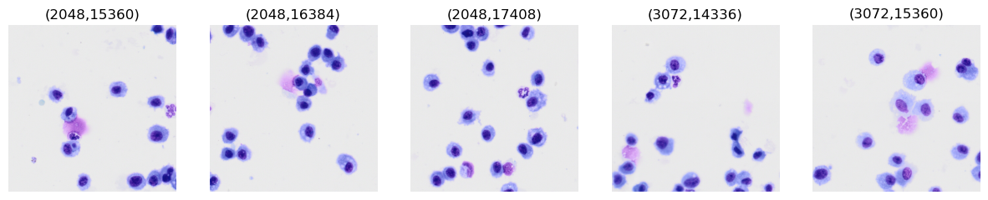
Scene | Objective | Channel name | Pixel size | Acquired
label | 2x PLN (NA 0.06) | "Label Scan" | 2.74 µm/px | 07:27:11
overview | 2x PLN (NA 0.06) | "BF" (bright-field) | 2.74 µm/px | 07:27:20
40x_BF_01 | 40x UPLXAPO oil (NA 0.95) | "BF" | 0.137 µm/px | 07:46:17
macro image | (no Pixels/calibration metadata, just a plain RGB photo) | none

Slide 3


Goal: counting number of immune cells
Segmentation of cells
I.e., foreground vs background
Personal identifier per cell
Cell Class:
Should know what type of cell it is. To what degree?
Phagocytosis?
Touching cells should be separated.
Has the cell engulfed anything?

Slide 4
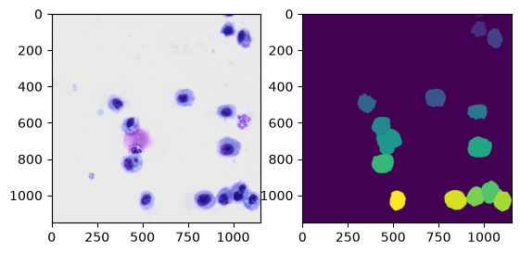
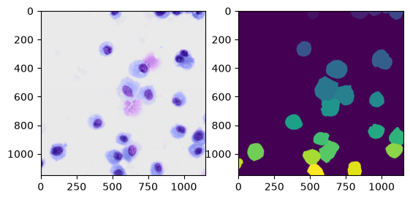
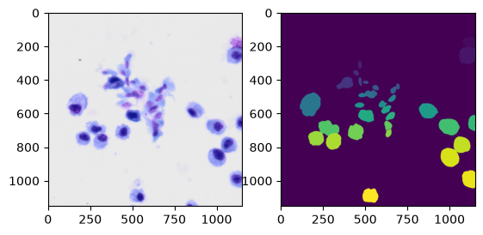
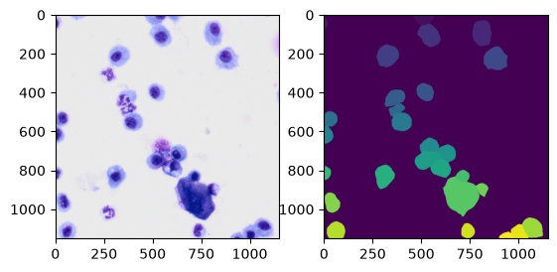
Example:
Divide into tiles
Segment
Extract features
Class level clustering

Slide 5
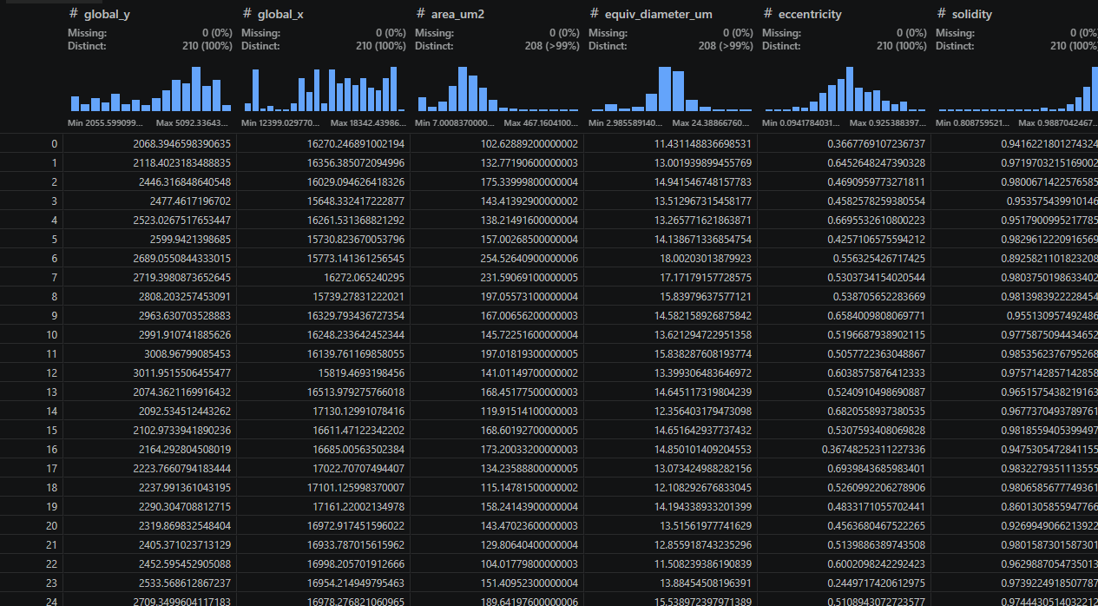
Example:
Divide into tiles
Segment
Extract features
Class level clustering

Slide 6
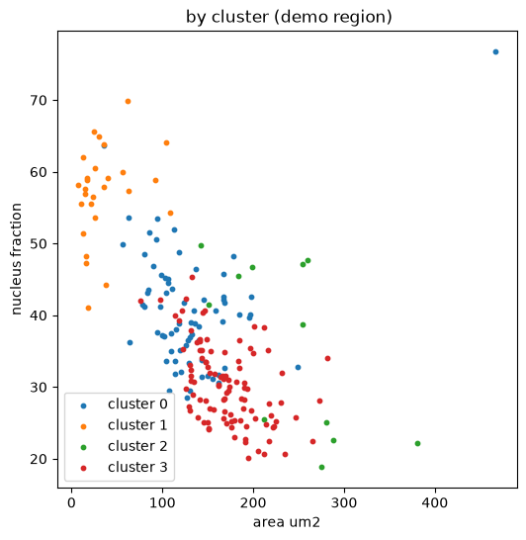
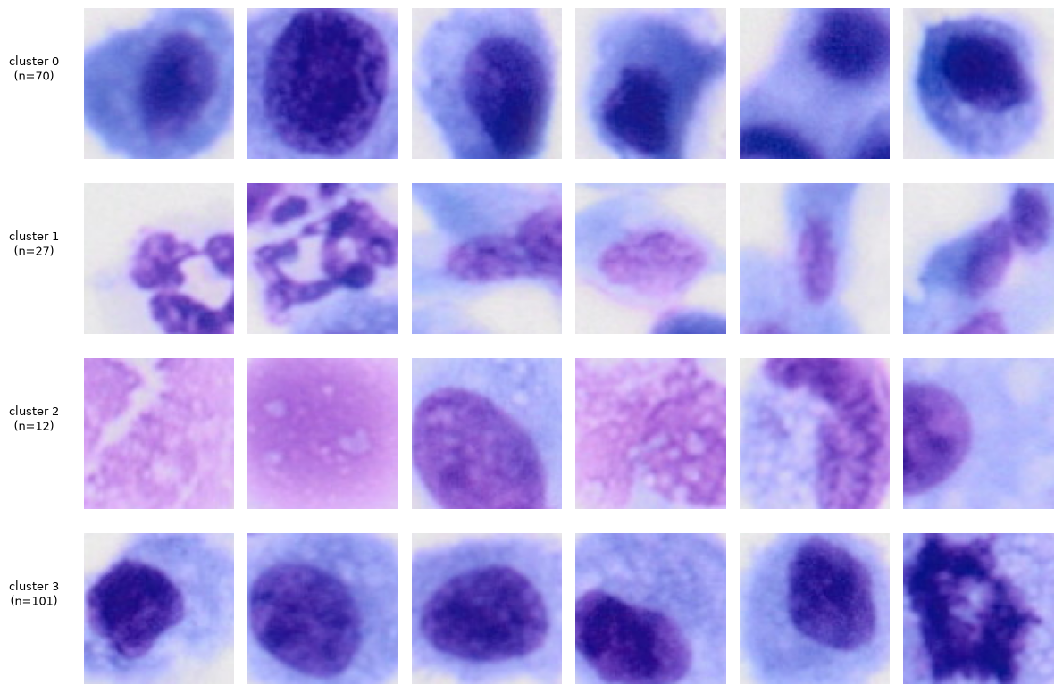
Example:
Divide into tiles
Segment
Extract features
Class level clustering

